Slide 1
Exploratory Data Analysis Soukhna Wade
FINAL PROJECT DSC530

Slide 2
Introduction
My previous analysis indicates that my data has 22 variables that I am going to describe them by drawing their histogram as well. Also, I am going to study the relationship between variables x and y known as correlation in a statistical study. I will create two scatter plots comparing two variables by providing analysis on correlation and causation, covariance, Pearson's correlation, and Non-linear relationships for the report. To the end of the study, I will conduct a test hypothesis.

Slide 3
Main Topic FGM
The report consists of female genital mutilation (FGM) Data Analysis. This topic is found under "Tableau Community Forums" with a large dataset, but I am going to limit my review to some areas. The data of female genital mutilation (FGM) are founded by UNICEF(United Nations International Children's Fund).

Slide 4
What is FGM ? And what are the four types FGM?
FGM is called female circumcision, which means female genital cutting. The FGM is including any procedure involving the removal or injury of part or all external female genitalia without any medical reasons. This practice is most commonly used around the world, for example, in the Middle East, Africa, and Asia. Also, the practice of FGM is discovered in the USA in the immigrant communities and metropolitan areas. There are four types of female genital mutilation: clitoridectomy, excision, infibulation, and a harmful one. The last one is harmful because of the pressure of pricking, piercing, incising, scraping, and cauterization.

Slide 5
Questions
How many girls aged 0-14 years have undergone female genital mutilation (FGM)?
How many percentage of girls and women from aged 15-49 years have undergone female genital mutilation (FGM)?
How many percentage of women from aged 15-49 years think that FGM should be eliminated?
How many percentage of boys and men from aged 15-49 years think that FGM should be eliminated

Slide 6
Where is found Dataset?
https://community.tableau.com/docs/DOC-10635
The dataset used is from the above link, and it is found initially under "Tableau Community Forums" and generated by UNICEF(United Nations International Children's Fund).

Slide 7
Importing dataset using Jupyter Notebook
 | Time Period | Observation Value | Unit Multiplier | Lower Bound | Upper Bound | Weighted Sample Size | Series Footnote | Citation of or link to the data source | Custodian | Reference Period
count | 39.000000 | 39.000000 | 0.0 | 0.0 | 0.0 | 0.0 | 0.0 | 0.0 | 0.0 | 0.0
mean | 2016.102564 | 44.851282 | NaN | NaN | NaN | NaN | NaN | NaN | NaN | NaN
std | 0.940181 | 32.289862 | NaN | NaN | NaN | NaN | NaN | NaN | NaN | NaN
min | 2015.000000 | 0.300000 | NaN | NaN | NaN | NaN | NaN | NaN | NaN | NaN
25% | 2015.000000 | 14.250000 | NaN | NaN | NaN | NaN | NaN | NaN | NaN | NaN

Slide 8
Get a list of column in the dataset
Index(['Dataflow', 'Geographic Area', 'Indicator', 'Sex', 'Time Period',
'Observation Value', 'Unit Multiplier', 'Unit of Measure',
'Observation Status', 'Observation Confidentaility', 'Lower Bound',
'Upper Bound', 'Weighted Sample Size', 'Observation Footnote',
'Series Footnote', 'Data Source',
'Citation of or link to the data source', 'Custodian',
'Time period activity related to when the data are collected',
'Reference Period', 'The period of time for which data are provided',
'Current Age'],
dtype='object')

Slide 9
EXPLORE THE DATA
The following result using code from R programming: glimpse(data) Observations: 39 Variables: 22 $ Dataflow <fct> Cross-sector Indicators, Cross-sector Indicators, Cross-sect... $ Geographic.Area <fct> CÃ´te d'Ivoire, Egypt, Ethiopia, Guinea, Iraq, Mali, Maurita... $ Indicator <fct> Percentage of girls (aged 0-14 years) who have undergone fem... $ Sex <fct> Total, Total, Total, Total, Total, Total, Total, Total, Tota... $ Time.Period <int> 2016, 2015, 2016, 2016, 2018, 2015, 2015, 2017, 2017, 2017, ... $ Observation.Value <dbl> 10.1, 14.1, 15.7, 45.1, 0.5, 73.2, 51.4, 12.7, 13.9, 8.4, 0.... $ Unit.Multiplier <lgl> NA, NA, NA, NA, NA, NA, NA, NA, NA, NA, NA, NA, NA, NA, NA, ... $ Unit.of.Measure <fct> %, %, %, %, %, %, %, %, %, %, %, %, %, %, %, %, %, %, %, %, ... $ Observation.Status <fct> Reanalysed, Reported, Reported, Reanalysed, Reported, Reanal... $ Observation.Confidentaility <fct> Free, Free, Free, Free, Free, Free, Free, Free, Free, Free, ... $ Lower.Bound <lgl> NA, NA, NA, NA, NA, NA, NA, NA, NA, NA, NA, NA, NA, NA, NA, ... $ Upper.Bound <lgl> NA, NA, NA, NA, NA, NA, NA, NA, NA, NA, NA, NA, NA, NA, NA, ... $ Weighted.Sample.Size <lgl> NA, NA, NA, NA, NA, NA, NA, NA, NA, NA, NA, NA, NA, NA, NA, ... $ Observation.Footnote <fct> "Due to an error in the syntax used for the final report, re... $ Series.Footnote <lgl> NA, NA, NA, NA, NA, NA, NA, NA, NA, NA, NA, NA, NA, NA, NA, ... $ Data.Source <fct> MICS 2016, Health Issues Survey (DHS) 2015, DHS 2016, MICS 2... $ Citation.of.or.link.to.the.data.source <lgl> NA, NA, NA, NA, NA, NA, NA, NA, NA, NA, NA, NA, NA, NA, NA, ... $ Custodian <lgl> NA, NA, NA, NA, NA, NA, NA, NA, NA, NA, NA, NA, NA, NA, NA, ... $ Time.period.activity.related.to.when.the.data.are.collected <fct> End of fieldwork, End of fieldwork, End of fieldwork, End of... $ Reference.Period <lgl> NA, NA, NA, NA, NA, NA, NA, NA, NA, NA, NA, NA, NA, NA, NA, ... $ The.period.of.time.for.which.data.are.provided <fct> 2016, 2015, 2016, 2016, 2018, 2015, 2015, 2016-17, 2017, 201... $ Current.Age <fct> Under 15 years old, Under 15 years old, Under 15 years old, ...
Note : Time Period is integer, and observation value is double
>

Slide 10
Identify five variables out of twenty two variables
'Dataflow’
'Geographic Area’
'Indicator’,
'Time Period',
'Observation Value',

Slide 11
Columns
Colnames (data) [1] "Dataflow" "Geographic.Area" [3] "Indicator" "Sex" [5] "Time.Period" "Observation.Value" [7] "Unit.Multiplier" "Unit.of.Measure" [9] "Observation.Status" "Observation.Confidentaility" [11] "Lower.Bound" "Upper.Bound" [13] "Weighted.Sample.Size" "Observation.Footnote" [15] "Series.Footnote" "Data.Source" [17] "Citation.of.or.link.to.the.data.source" "Custodian" [19] "Time.period.activity.related.to.when.the.data.are.collected" "Reference.Period" [21] "The.period.of.time.for.which.data.are.provided" "Current.Age"

Slide 12
Cleaning dataset
Extracting and filtering the information that is needed for problem-solving. Quality of the model is highly dependant on the quality of the data that is given as an input.
Identify errors and understand the meaning of every feature.
Look for any missing values(NA) and find a way to fill the missing values.
Remove duplicate or corrupted records.
Character encoding converts a string to numerical representation.

Slide 13
Data Correlation
Time Period | Observation Value | Lower Bound | Upper Bound | Weighted Sample Size | Series Footnote | Citation of or link to the data source | Custodian | Reference Period
Time Period | 1.000000 | -0.127343 | NaN | NaN | NaN | NaN | NaN | NaN | NaN
Observation Value | -0.127343 | 1.000000 | NaN | NaN | NaN | NaN | NaN | NaN | NaN
Lower Bound | NaN | NaN | NaN | NaN | NaN | NaN | NaN | NaN | NaN
Upper Bound | NaN | NaN | NaN | NaN | NaN | NaN | NaN | NaN | NaN
Weighted Sample Size | NaN | NaN | NaN | NaN | NaN | NaN | NaN | NaN | NaN
Series Footnote | NaN | NaN | NaN | NaN | NaN | NaN | NaN | NaN | NaN
Citation of or link to the data source | NaN | NaN | NaN | NaN | NaN | NaN | NaN | NaN | NaN

Slide 14
Using R Programing library(Hmisc) data.rcorr = rcorr(as.matrix(data$Observation.Value, data$Time.Period))
data.rcorr = rcorr(as.matrix(data$Observation.Value, data$Time.Period))
data.rcorr
Resutls: [,1] [1,] 1 n= 39 P [,1] [1,]

Slide 15
Pearson correlation
[1] -0.1273432
data.cor= cor(data$Observation.Value, data$Time.Period, method = c("pearson"))
Result: -0,1273432 indicates a negative correlation
In statistics, as a result, a perfect negative correlation is represented by the value -1,
0 indicates no relationship,
and +1 indicates a perfect positive correlation
The negative correlation is a relationship between two variables in which one variable increases as the other decreases, and vice versa.

Slide 16
Regression Analysis
Run a regression analysis where Time.Period predicts Observation.Value.
mod <- lm(Time.Period ~ Observation.Value, data)
mod
Result:
Coefficients:
(Intercept) Observation.Value
2.016e+03 -3.708e-03

Slide 17
Predicting model using R
predict(mod, Time.Period=Observation.Value)
> predict(mod, Time.Period=Observation.Value) 1 2 3 4 5 6 7 8 9 10 11 12 13 14 2016.231 2016.217 2016.211 2016.102 2016.267 2015.997 2016.078 2016.222 2016.217 2016.238 2016.267 2016.126 2016.133 2015.946 15 16 17 18 19 20 21 22 23 24 25 26 27 28 2016.027 2015.910 2016.241 2015.962 2016.022 2016.201 2016.180 2015.950 2016.268 2016.232 2016.102 2016.130 2015.917 2015.975 29 30 31 32 33 34 35 36 37 38 39 2016.085 2016.189 2015.974 2016.019 2016.215 2016.169 2015.922 2015.969 2015.947 2015.977 2016.165
>

Slide 18
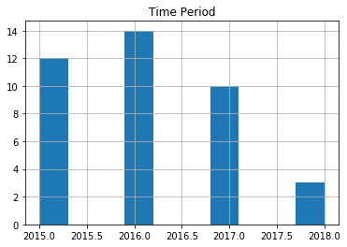
Histogram

Slide 19
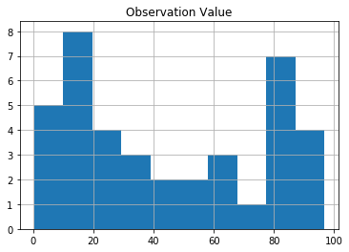
Histogram

Slide 20
Scatter plot using R
library(ggplot2)
ggplot2 <- ggplot(data, aes(x = Observation.Value, y = Time.Period)) + geom_point()
ggplot2

Slide 21
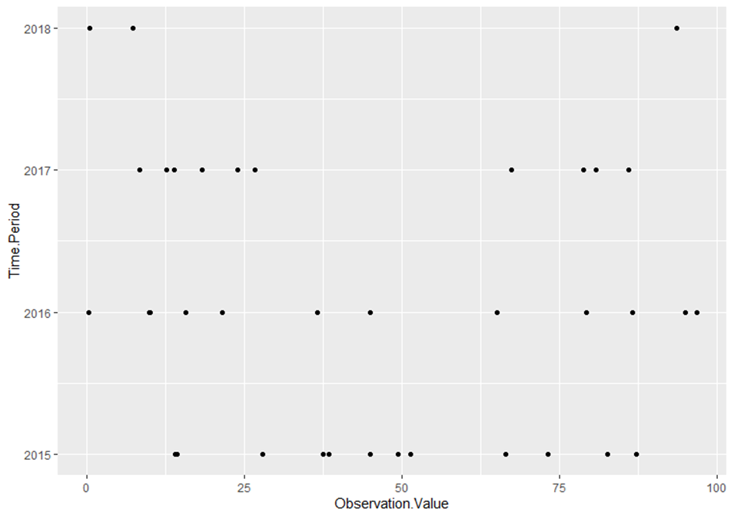
Scatter plot
Data visualization with ggplot2
library(ggplot2)
ggplot2 <- ggplot(data, aes(x = Observation.Value, y = Time.Period)) + geom_point()
ggplot2

Slide 22
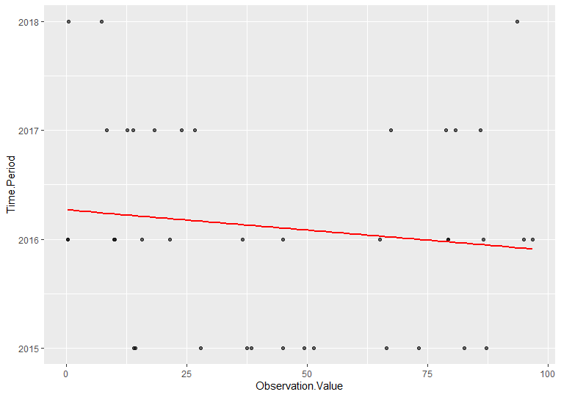
Explore Statistic : Eda using linear model
ggplot2 <- ggplot(data, aes(x = Observation.Value, y = Time.Period)) +
geom_point(alpha = 0.6) + stat_smooth(method = "lm", col = "red", se = FALSE)
ggplot2

Slide 23
Hypothesis
How many countries are planning to eliminate the type (infibulation) for girls aged 0-14 years who have undergone female genital mutilation (FGM)?
When these countries involved are going to action the plan to eliminate infibulation?
How to stop it?

